Slide 1
Your First Forward Pass in Neural Network
Subtitle

Slide 2
Title and Content Layout with List
Add your first bullet point here
Add your second bullet point here
Add your third bullet point here

Slide 3
Title and Content Layout with Chart

Slide 4
Two Content Layout with Table
First bullet point here
Second bullet point here
Third bullet point here
Class | Group A | Group B
Class 1 | 82 | 95
Class 2 | 76 | 88
Class 3 | 84 | 90

Slide 5
Two Content Layout with SmartArt
First bullet point here
Second bullet point here
Third bullet point here
Group A
Task 1
Task 2
Group B
Task 1
Task 2
Task 3
Task 4
Task 3

Slide 6
Add a Slide Title - 1

Slide 7
What is a forward pass?
Input data is passed forward or
propagated through a network
Computations performed at each layer
Outputs of each layer passed to each subsequent layer
Output of final layer: "prediction" Used for both training and prediction
Some possible outputs: Binary classification
Single probability between 0 and 1
Multiclass classification
Distribution of probabilities summing to 1
Regression values
Continuous numerical predictions

Slide 8
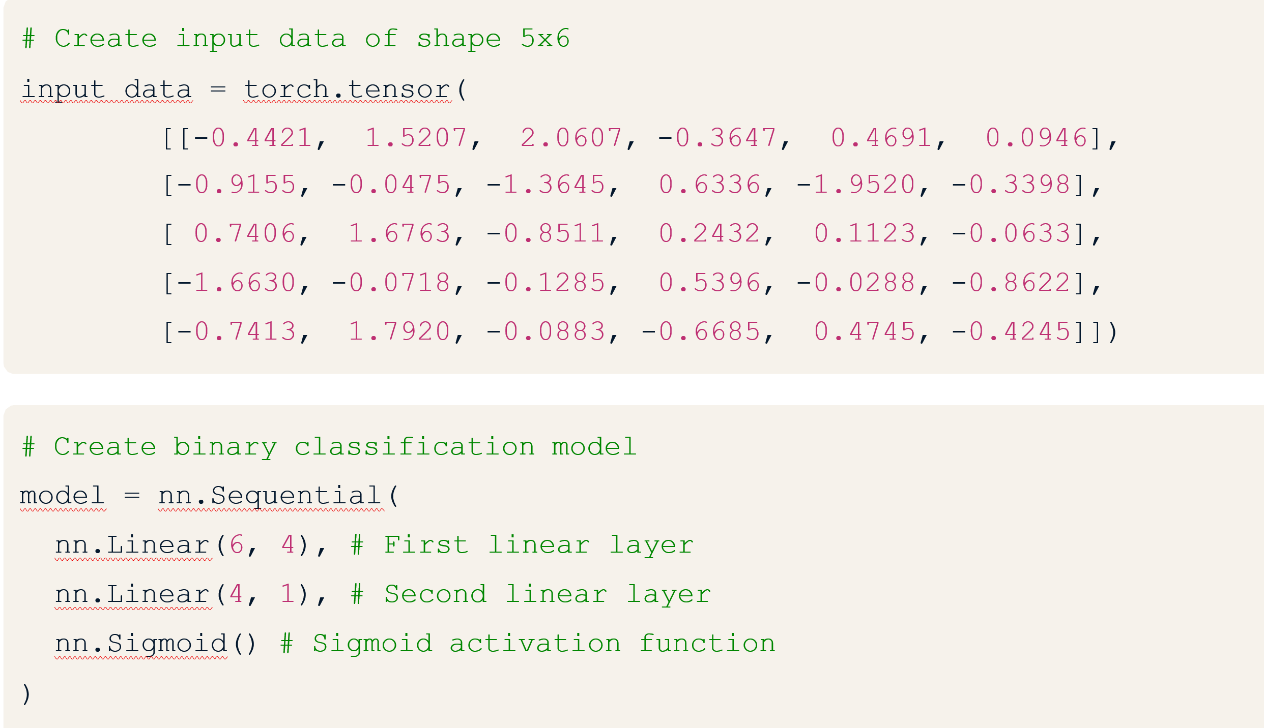
Is there also a backward pass?
Backward pass, or backpropagation is used to update weights and biases during training In the "training loop", we:
1. Propagate data forward
2. Compare outputs to true values (ground-truth)
3. Backpropagate to update model weights and biases
4. Repeat until weights and biases are tuned to produce useful outputs
Binary classification: forward pass

Slide 9
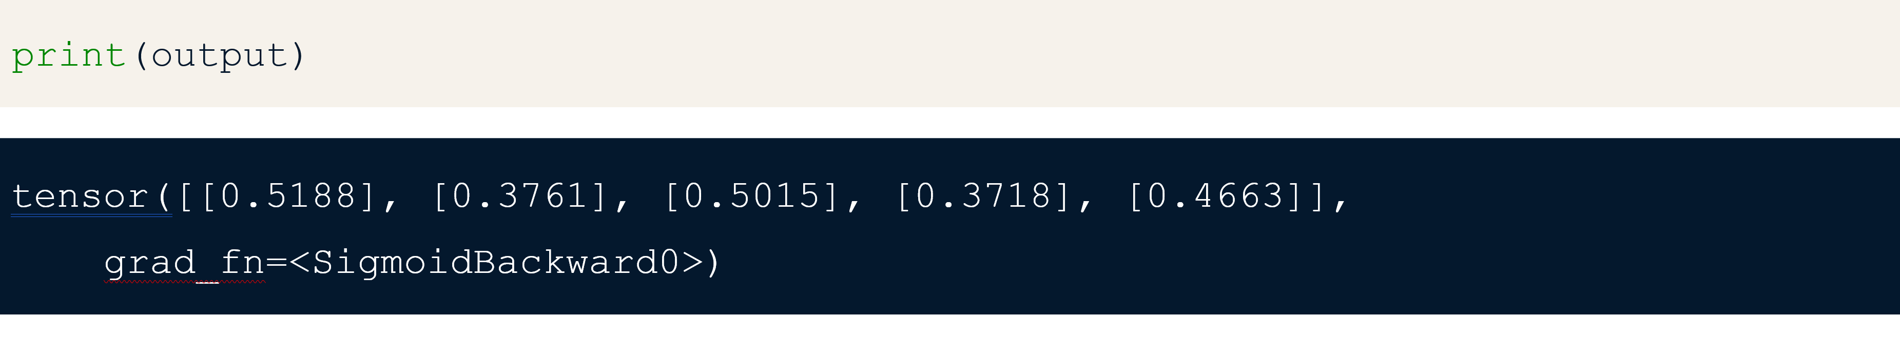
Binary classification: forward pass
# Pass input data through model
output = model(input_data)
Outputs:
five probabilities between zero and one one value for each sample (row) in data
Classification:
Class = 1 for first and third values: ,
Class = 0 for second, fourth and fifth values:

Slide 10
Add a Slide Title - 4

Slide 11
Add a Slide Title - 5

